Slide 1

Project phase A
24-1-R-19
Wildfire segmentation based on Yolo and attention U-Net
supervisor:
prof. Miri Weiss Cohen
students:
Avner Ben Shlomo
Dor Filis

Slide 2
Agenda
Introduction - Wildfire
Motivation
YOLOv4
Segmentation
Attention UNET
Research
Proposed approach
Hyperparameters
Expected Achievements
UML + Flow chart
GUI
Tests

Slide 3
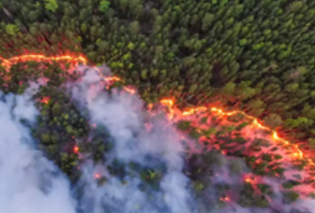
Introduction - Wildfire
Wildfires devastate communities, farmlands, and animal habitats worldwide.
Increased frequency attributed to global warming rising temperatures.
current solutions:
Sensor and Long-Range Camera Systems
Ground-Based Sensor Systems
Sound-Based Technologies
Floating Devices (Balloons or Spheres)

Slide 4
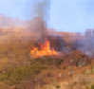
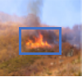
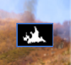
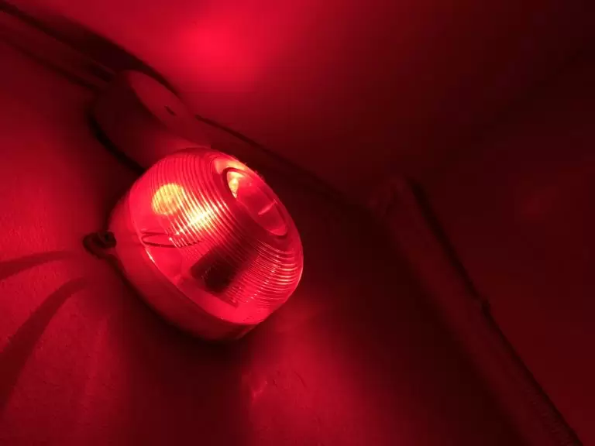
Motivation
"Early wildfire detection:
essential protection."

Slide 5
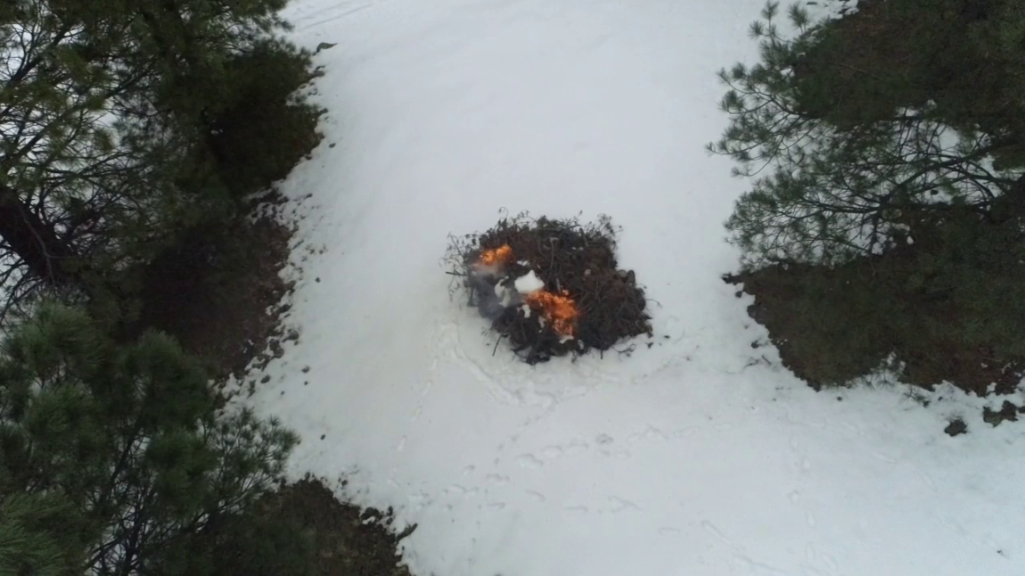
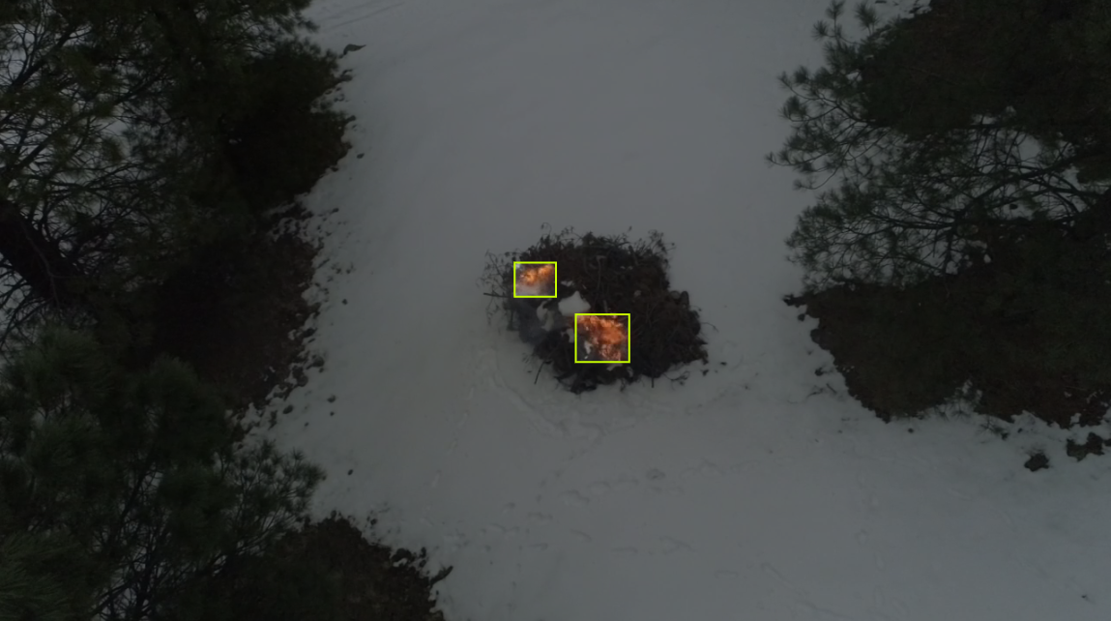
YOLO
YOLO (You Only Look Once) is an object detection deep learning model , initially developed by Joseph Redmon and Ali Farhadi in 2015.
Since its inception, there have been eight different versions, with the latest being YOLO V8 released in 2023

Slide 6
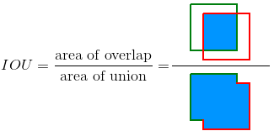

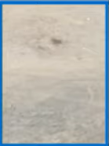
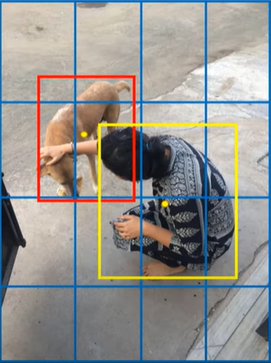
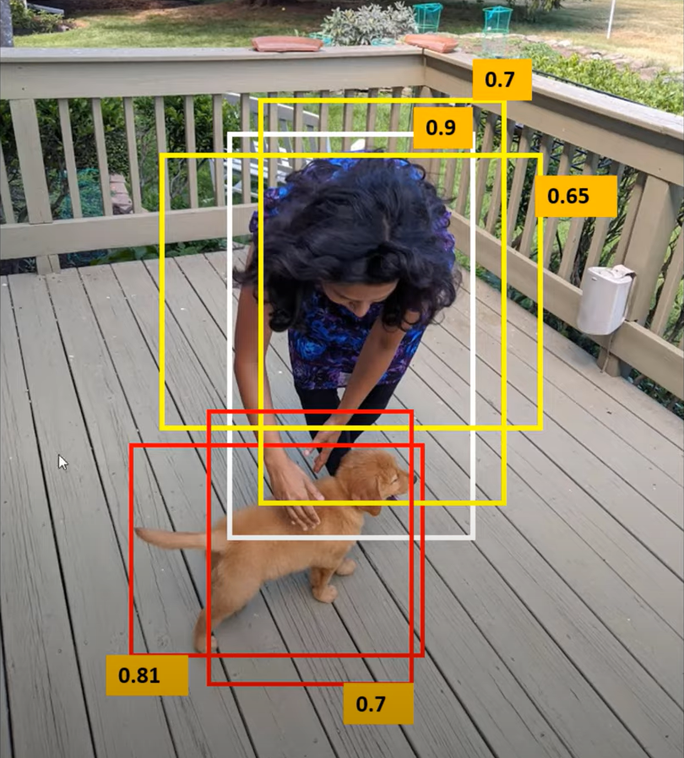
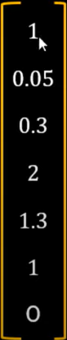
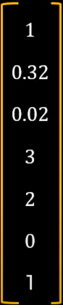
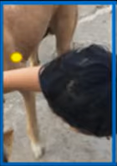
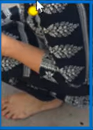
How YOLO works?

Slide 7
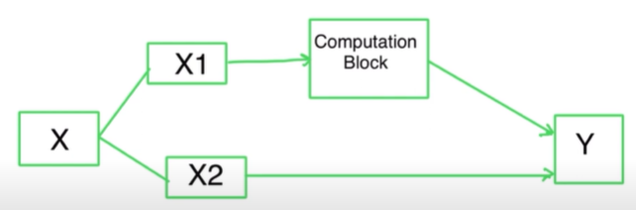
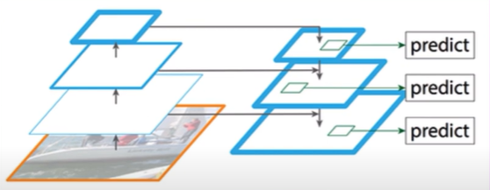
YOLOv4
Input
Backbone - CSPDarkNet53
Used for feature extraction
Neck
Collect feature maps from different stages
Head - YOLO

Slide 8
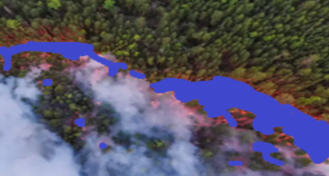
Segmentation
A Process of labeling each pixel of an image with a corresponding class.

Slide 9
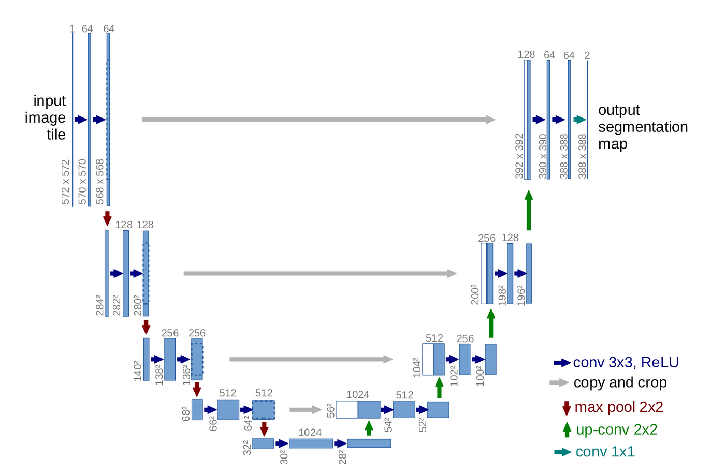
UNET
Design: U-shaped architecture
Downsample Blocks:
Capture features at different levels by reducing image size.
Upsample Blocks:
Restore image size while combining features from downsample blocks.

Slide 10
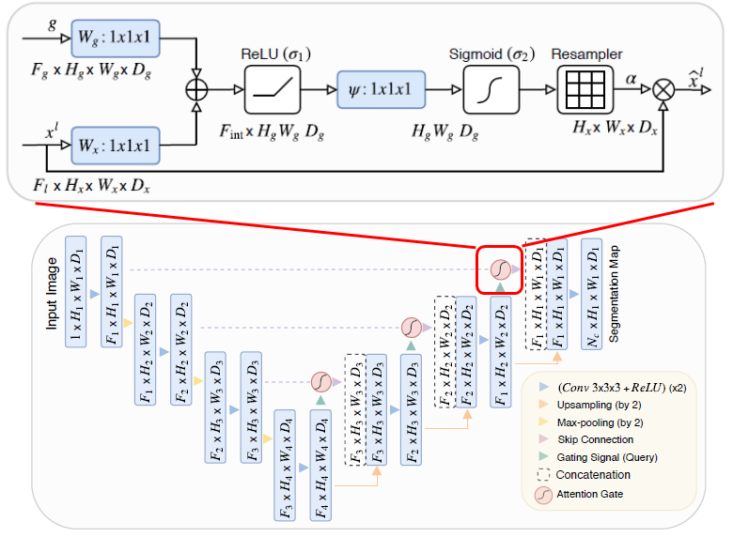
Attention UNET
Attention Blocks:
Focus on the most important features, improving accuracy.

Slide 11
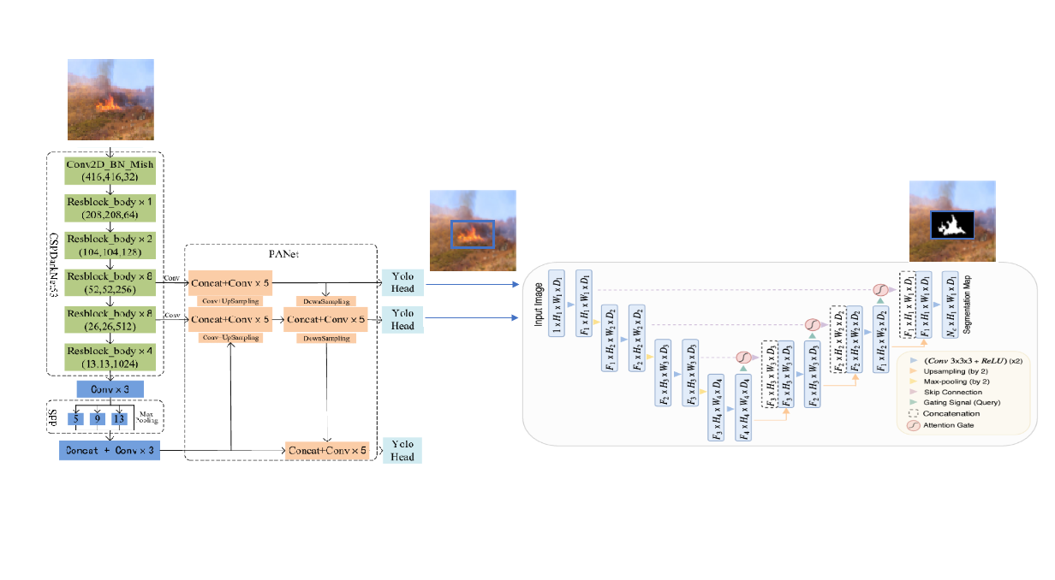
Proposed approach:

Slide 12
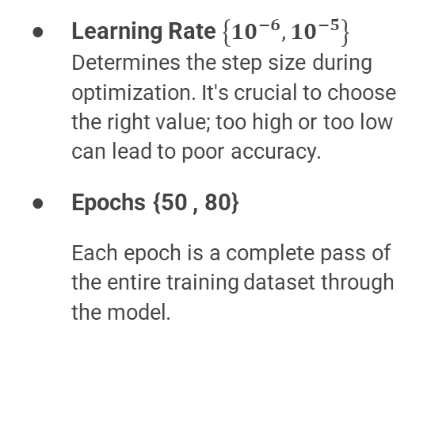
Research process - Hyperparameters
Learning Rate $\left\{10^{−6},10^{−5}\right\}$ Determines the step size during optimization. It's crucial to choose the right value; too high or too low can lead to poor accuracy.
Epochs {50 , 80}
Each epoch is a complete pass of the entire training dataset through the model.
Batch Size {32,64,128}
Number of images processed in one batch through the network.
Loss function {BCE, Dice score}
Measures the difference between the predicted output and the actual target, guiding the optimization process to improve model accuracy.

Slide 13
Expected Achievements
We aim to develop a system capable of segmenting multiple wildfire scenarios in forests using YOLOv4 and Attention U-Net architectures for improved accuracy in real time.
For us, success will be described in:
Achieve at least 0.9 segmentation accuracy.
Identify the optimal hyperparameter combination for best results.
Perform segmentation on videos in real time.

Slide 14
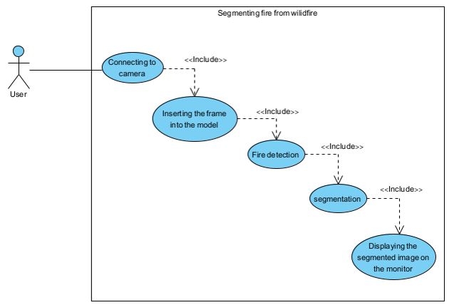
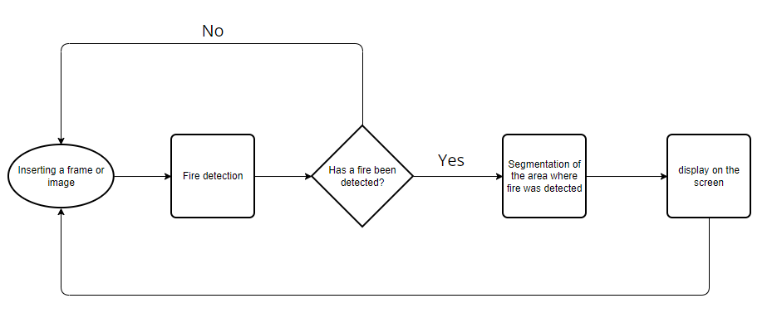
UML: Flow chart:

Slide 15
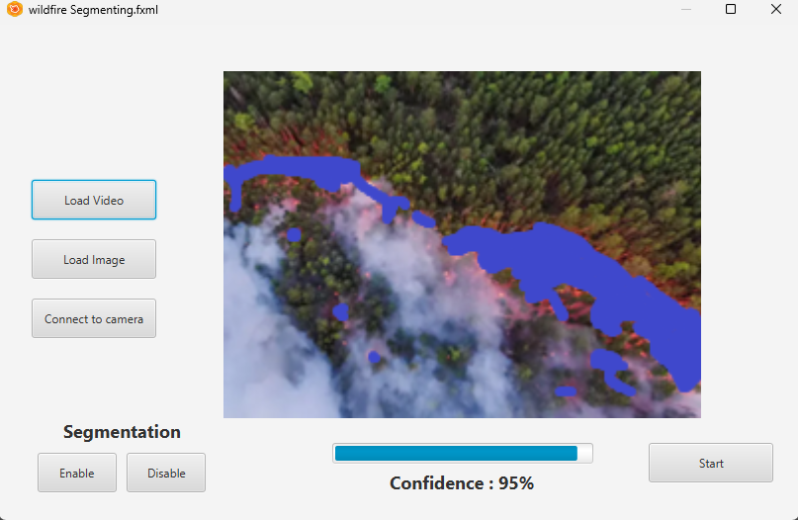
GUI

Slide 16
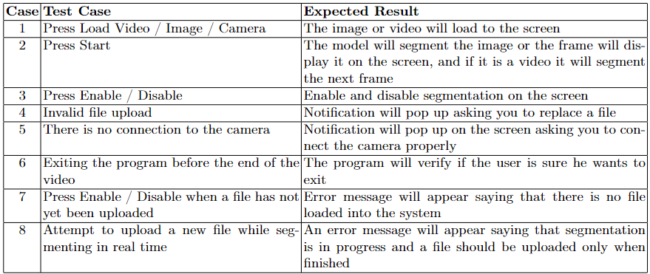
Tests

Slide 17
Thank
You

